Slide 1
Software and Its Changes Impacting Business: For the Software…it’s a-changin’
SOFTWARE

Slide 2
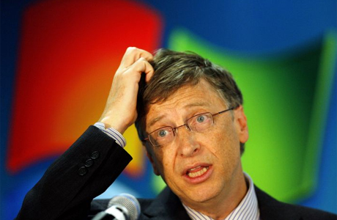
The software, it’s a changin’
What is all this stuff??
The fundamental model powering the software industry is under assault
“Microsoft generates one and a half billion dollars a month from Windows and Office alone.”
What is assaulting the software industry??
Open Source Software: free alternatives where anyone can look at and potentially modify a program’s code—pose a direct challenge to the assets and advantages cultivated by market leaders
Cloud Computing: replacing computing resources—either an organization’s or an individual’s hardware or software—with services provided over the Internet
Virtualization: make a single computer behave like many separate machines
Mobile: the use of apps on smartphones/tablets

Slide 3
Open Source Software
What is Open Source Software?
often described as free – meaning liberated
source code is openly shared

Slide 4
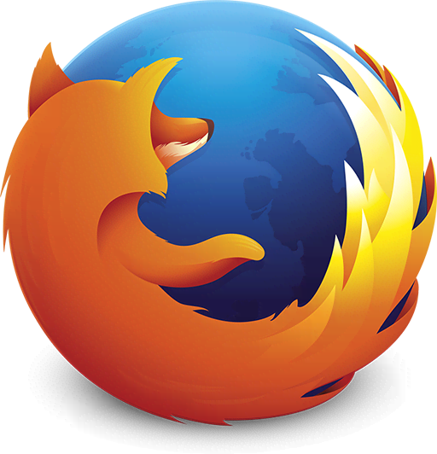
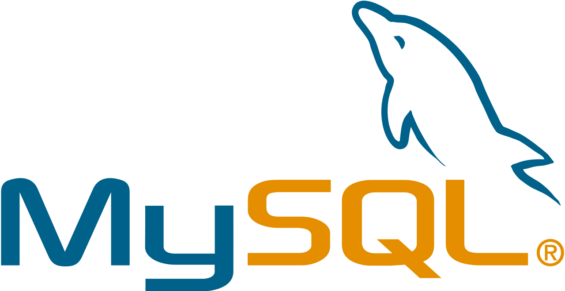
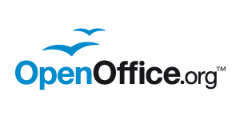
Open Source Software:
Examples
http://oss-watch.ac.uk/resources/softwareexamples
Linus Torvalds developed Linux and then GAVE IT AWAY FOR FREE!!
Operating system on 16 to 30 percent of the servers in corporate America
Introduction to Linux
Nearly every major hardware firm and a list of tech giants (e.g., Box, Facebook, Google, IBM, LinkedIn, Netflix, and Twitter) has paid staff contributing to open source projects!!

Slide 5
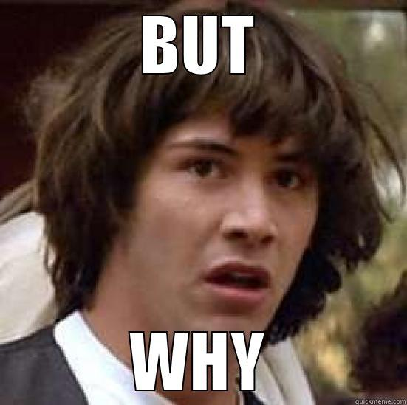
Open Source Software: Why?
Cost: FREE (or MUCH cheaper)
Banking giant Barclays has been able to reduce software costs by 90 percent by switching to open source products
Amazon claimed in SEC filings that the switch to open source was a key contributor to nearly $20 million in tech savings
TiVo, which use OSS in their own products, eliminate a cost spent either developing their own operating system or licensing similar software from a vendor like Microsoft
Reliability: “Given enough eyeballs, all bugs are shallow.”
the power of legions of geeks who are constantly trawling OSS products, looking to squash bugs and improve product quality
Security: by allowing “many eyes” to examine the code, the security vulnerabilities of open source products come to light more quickly and can be addressed with greater speed and reliability
High-profile hacking contests (Windows and Mac Lost; Linux reigned supreme!!)
Scalability: allows a firm to scale from start-up to blue chip without having to significantly rewrite their code, potentially saving big on software development costs
E*TRADE credits its scalable open source systems for maintaining performance while competitors’ systems struggled
Agility and Time to Market: may be able to skip whole segments of the software development process, allowing new products to reach the market faster than if the entire software system had to be developed from scratch, in-house
Motorola has claimed that customizing products built on OSS has helped speed time-to-market for the firm’s mobile phones

Slide 6
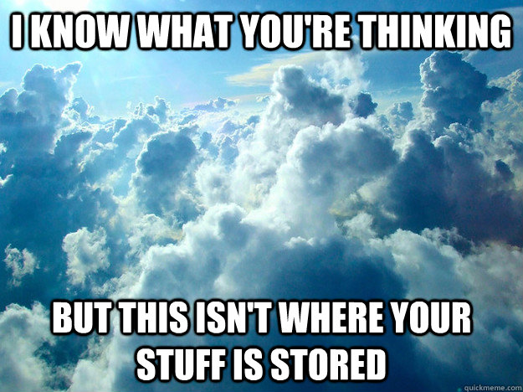
Cloud Computing: What is the CLOUD??

Slide 7
Cloud Computing: What is the CLOUD??
Video 1: What is Cloud Computing?
Cloud computing is basically replacing computing resources—either an organization’s or an individual’s hardware or software—with services provided over the Internet
Software as Service: firm subscribes to a third-party software-replacing service that is delivered online
http://www.salesforce.com/
Gmail; Outlook Web App; Office 365; Zoho
Platform as a Service: delivers tools (a.k.a. a platform) so an organization can develop, test, and deploy software in the cloud
https://cloud.google.com/appengine/docs
Infrastructure as a Service: offers an organization an alternative to buying its own physical hardware—that is, computing, storage, and networking resources are instead allocated and made available over the Internet and are paid for based on the amount of resources used
Rackspace.com
Amazon Web Services
Video 1:
Video 2: Cloud Computing and IaaS, PaaS, SaaS

Slide 8
Cloud Computing: Benefits of SaaS
Software as Service: firm subscribes to a third-party software-replacing service that is delivered online
http://www.salesforce.com/
Gmail; Outlook Web App; Office 365; Zoho
Forgo the large upfront costs of buying and installing software packages;
SaaS can bring cost savings of 25 to 60 percent if all these costs are factored in
Added cost for the IT staff needed to run these systems
Firms that adopt software as a service never actually buy a system’s software and hardware (e.g., PAY AS YOU GO)
Becomes variable operating expense, not FIXED
Highly scalable (use as much or as little computing capacity when you need it the most)
SaaS provider develops, tests, deploys, and supports just one version of the software executing on its own servers
As much as 30 percent of the price of traditional desktop software is tied to the cost of distribution

Slide 9
Cloud Computing: Risks of SaaS
Software as Service: firm subscribes to a third-party software-replacing service that is delivered online
http://www.salesforce.com/
Gmail; Outlook Web App; Office 365; Zoho
long-term viability of partner firms
may be forced to migrate to new versions—possibly incurring unforeseen training costs and shifts in operating procedures
reliance on a network connection—which may be slower, less stable, and less secure
data asset stored off-site—with the potential for security and legal concerns.
limited configuration, customization, and system integration options compared to packaged software or alternatives developed in-house.
user interface of Web-based software is often less sophisticated and lacks the richness of most desktop alternatives.

Slide 10
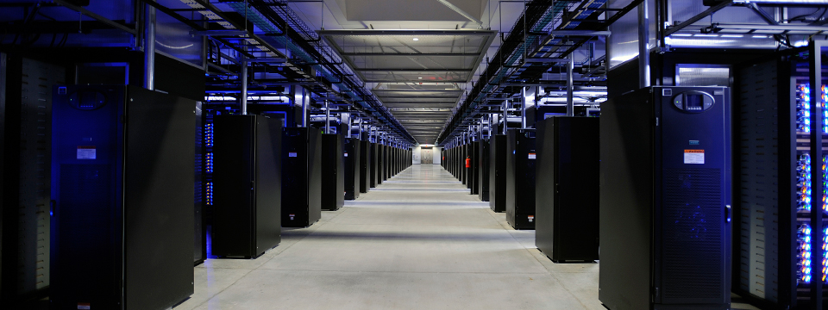
Cloud Computing:
What Does it Take to Run This Thing?
Inside a Facebook Data Center

Slide 11
Cloud & Virtualization:
Software That Makes One Computer Act Like Many
Virtualization Explained by VMWare
Virtualization:
can generate huge savings in hardware, staff, and real estate
reduces a firm’s IT-based energy consumption, cutting costs, lowering its carbon footprint
conventional data centers run at 15 percent or less of their maximum capacity
Data centers using virtualization software have increased utilization to 80 percent or more
Virtual Desktops:
a server runs what amounts to a copy of a PC—OS, applications, and all—and simply deliver an image of what’s executing to a PC or other connected device
Firms can then scale, back up, secure, and upgrade systems far more easily than if they had to maintain each individual PC

Slide 12
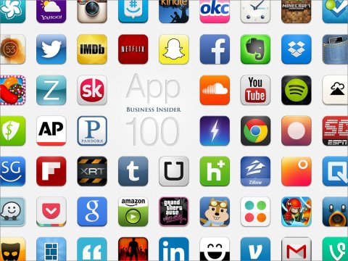
Further Software Disruption:
Apps, Apps, & more Apps
“More monumental changes are being brought about by app stores, specifically the use of apps on smartphones. Smartphones have surpassed the one-billion-unit-sales-per-year milestone, and costs are plummeting. For many worldwide, the smartphone is the primary screen for engaging in a series of tasks or entire new categories of software and services. And while smartphones use the web, most smartphone functionality is delivered via custom apps.”

Slide 13
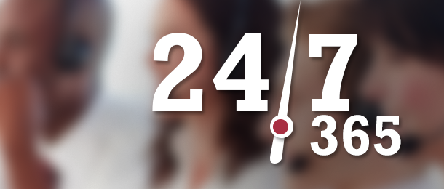
Apps, Apps, & more Apps: Benefits
Apps integrate with the OS, whereas the web provides no such OS-level integration
Many products will upgrade apps in the background
Richer, more interactive interface options than simple web-based applications
Several businesses simply would not exist without apps to engage with customers

Slide 14
Apps, Apps, & more Apps: Criticisms
Lock a user into a given platform
Require software developers to create a package using developer tools provided by
mobile device manufacturers, further deepening switching costs
Data is more tightly controlled by a service provider and firms must comply to the usage policies of the platform provided (e.g., Apple, Google, Amazon, or Microsoft)
Crowded app stores increasingly make it more challenging for a potential star to rise above the din of the crowd and get recognized

